Slide 1

DIVINE GRACE COLLEGE OF ARTS, SCIENCE AND TECHNOLOGY
(DGCAST) — GAROUA | GEOGRAPHY DEPARTMENT
UPPER SIXTH ARTS — ENVIRONMENT AND DEVELOPMENT — LESSON 10
Globalisation
Mr KAMDEM EMMANUEL
Geography Teacher — PLEG
Academic Year 2026 / 2027
Notes:
Good morning, class. Today we study Lesson 10: Globalisation.

Slide 2
GEOGRAPHY — UPPER SIXTH ARTS
CLASS INFO
Class, Chapter & Duration
Class | Upper Sixth Arts
Chapter | Module 7: Understanding and managing contemporary environmental and development issues
Duration | 2 periods (2 × 50 minutes)
2026 / 2027
DGCAST GAROUA — GEOGRAPHY DEPARTMENT
Mr KAMDEM E. | 2

Slide 3
GEOGRAPHY — UPPER SIXTH ARTS
IDENTIFICATION
Lesson Identification
Topic | Current Development Issues
Sub-topic | Globalisation
Lesson | Lesson 10: Globalisation
Notions / Concepts | Globalisation, transnational corporation (TNC), containerisation, ICT, shrinking world.
Syllabus focus | Meaning; components; evidence; factors (TNCs, shipping and containerisation, air transport, ICT); positive and negative impacts.
Competence | Learners are able to explain globalisation, its factors and impacts.
2026 / 2027
DGCAST GAROUA — GEOGRAPHY DEPARTMENT
Mr KAMDEM E. | 3

Slide 4
GEOGRAPHY — UPPER SIXTH ARTS
OBJECTIVES
Learning Objectives
By the end of the lesson, the learner should be able to:
Define globalisation and its components.
Explain the factors of globalisation.
Evaluate its positive and negative impacts.
2026 / 2027
DGCAST GAROUA — GEOGRAPHY DEPARTMENT
Mr KAMDEM E. | 4

Slide 5
GEOGRAPHY — UPPER SIXTH ARTS
RECALL
Recall
Many goods in our markets come from abroad.
Phones connect people across the world.
2026 / 2027
DGCAST GAROUA — GEOGRAPHY DEPARTMENT
Mr KAMDEM E. | 5

Slide 6
GEOGRAPHY — UPPER SIXTH ARTS
REAL-LIFE SITUATION
Real-Life Situation
A student in Garoua wears clothes made in China, uses a phone designed in the USA and watches European football. Her uncle grows cotton that is sold to Asia.
2026 / 2027
DGCAST GAROUA — GEOGRAPHY DEPARTMENT
Mr KAMDEM E. | 6
Notes:
Read the situation slowly, twice.

Slide 7
GEOGRAPHY — UPPER SIXTH ARTS
REAL-LIFE SITUATION
Situation — Question 1
What is the problem in the situation?
2026 / 2027
DGCAST GAROUA — GEOGRAPHY DEPARTMENT
Mr KAMDEM E. | 7

Slide 8
GEOGRAPHY — UPPER SIXTH ARTS
REAL-LIFE SITUATION
Answer
Our lives are linked to the whole world.
2026 / 2027
DGCAST GAROUA — GEOGRAPHY DEPARTMENT
Mr KAMDEM E. | 8

Slide 9
GEOGRAPHY — UPPER SIXTH ARTS
REAL-LIFE SITUATION
Situation — Question 2
What is this process called?
2026 / 2027
DGCAST GAROUA — GEOGRAPHY DEPARTMENT
Mr KAMDEM E. | 9

Slide 10
GEOGRAPHY — UPPER SIXTH ARTS
REAL-LIFE SITUATION
Answer
Globalisation.
2026 / 2027
DGCAST GAROUA — GEOGRAPHY DEPARTMENT
Mr KAMDEM E. | 10

Slide 11
GEOGRAPHY — UPPER SIXTH ARTS
REAL-LIFE SITUATION
Situation — Question 3
Give one thing that makes it possible.
2026 / 2027
DGCAST GAROUA — GEOGRAPHY DEPARTMENT
Mr KAMDEM E. | 11

Slide 12
GEOGRAPHY — UPPER SIXTH ARTS
REAL-LIFE SITUATION
Possible Answer
Phones and internet (or ships and planes).
2026 / 2027
DGCAST GAROUA — GEOGRAPHY DEPARTMENT
Mr KAMDEM E. | 12

Slide 13
GEOGRAPHY — UPPER SIXTH ARTS
JUSTIFICATION
Justification of the Lesson
This lesson helps us to understand how the world is becoming one system.
2026 / 2027
DGCAST GAROUA — GEOGRAPHY DEPARTMENT
Mr KAMDEM E. | 13

Slide 14
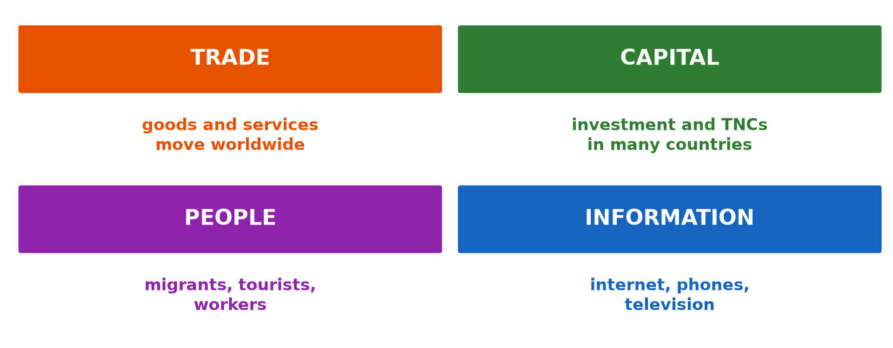
GEOGRAPHY — UPPER SIXTH ARTS
I. MEANING AND COMPONENTS
Activity 1
Components of globalisation.
2026 / 2027
DGCAST GAROUA — GEOGRAPHY DEPARTMENT
Mr KAMDEM E. | 14
Notes:
Without the projector: give an example of each.

Slide 15
GEOGRAPHY — UPPER SIXTH ARTS
I. MEANING AND COMPONENTS
Activity 1: Question
Name the four components of globalisation.
2026 / 2027
DGCAST GAROUA — GEOGRAPHY DEPARTMENT
Mr KAMDEM E. | 15

Slide 16
GEOGRAPHY — UPPER SIXTH ARTS
I. MEANING AND COMPONENTS
Answer
Trade, capital, people and information.
2026 / 2027
DGCAST GAROUA — GEOGRAPHY DEPARTMENT
Mr KAMDEM E. | 16

Slide 17

GEOGRAPHY — UPPER SIXTH ARTS
II. TNCs
Activity 2
Containers carrying goods worldwide.
2026 / 2027
DGCAST GAROUA — GEOGRAPHY DEPARTMENT
Mr KAMDEM E. | 17
Notes:
Without the projector: name TNCs in Cameroon.

Slide 18
GEOGRAPHY — UPPER SIXTH ARTS
II. TNCs
Activity 2: Question
What is a transnational corporation?
2026 / 2027
DGCAST GAROUA — GEOGRAPHY DEPARTMENT
Mr KAMDEM E. | 18

Slide 19
GEOGRAPHY — UPPER SIXTH ARTS
II. TNCs
Answer
A company that operates in many countries, like Total or Nestlé.
2026 / 2027
DGCAST GAROUA — GEOGRAPHY DEPARTMENT
Mr KAMDEM E. | 19

Slide 20
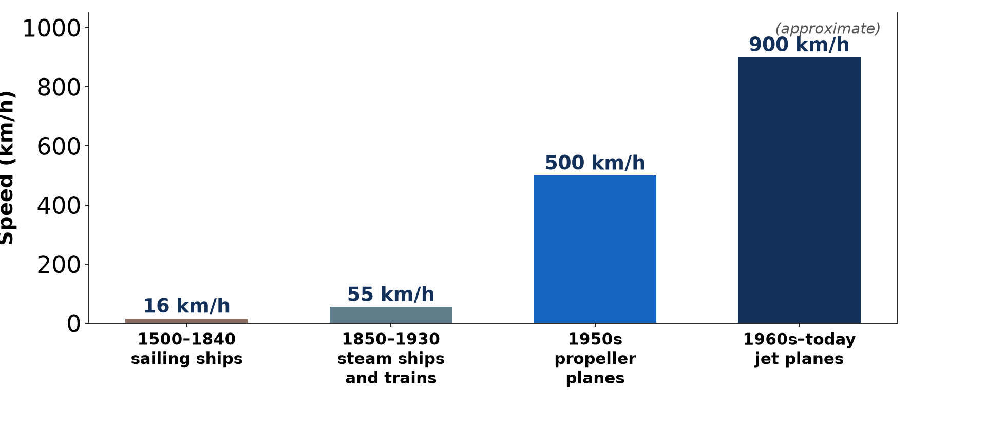
GEOGRAPHY — UPPER SIXTH ARTS
II. TRANSPORT
Activity 3
Faster transport (approximate).
2026 / 2027
DGCAST GAROUA — GEOGRAPHY DEPARTMENT
Mr KAMDEM E. | 20
Notes:
Without the projector: read the bars.

Slide 21
GEOGRAPHY — UPPER SIXTH ARTS
II. TRANSPORT
Activity 3: Question
How did transport make the world "shrink"?
2026 / 2027
DGCAST GAROUA — GEOGRAPHY DEPARTMENT
Mr KAMDEM E. | 21

Slide 22
GEOGRAPHY — UPPER SIXTH ARTS
II. TRANSPORT
Answer
Faster ships and jets reduced travel time between places.
2026 / 2027
DGCAST GAROUA — GEOGRAPHY DEPARTMENT
Mr KAMDEM E. | 22

Slide 23

GEOGRAPHY — UPPER SIXTH ARTS
II. ICT
Activity 4
An internet café.
2026 / 2027
DGCAST GAROUA — GEOGRAPHY DEPARTMENT
Mr KAMDEM E. | 23
Notes:
Without the projector: discuss phone use.

Slide 24
GEOGRAPHY — UPPER SIXTH ARTS
II. ICT
Activity 4: Question
How does ICT help globalisation?
2026 / 2027
DGCAST GAROUA — GEOGRAPHY DEPARTMENT
Mr KAMDEM E. | 24

Slide 25
GEOGRAPHY — UPPER SIXTH ARTS
II. ICT
Answer
Internet and phones send information and money instantly everywhere.
2026 / 2027
DGCAST GAROUA — GEOGRAPHY DEPARTMENT
Mr KAMDEM E. | 25

Slide 26
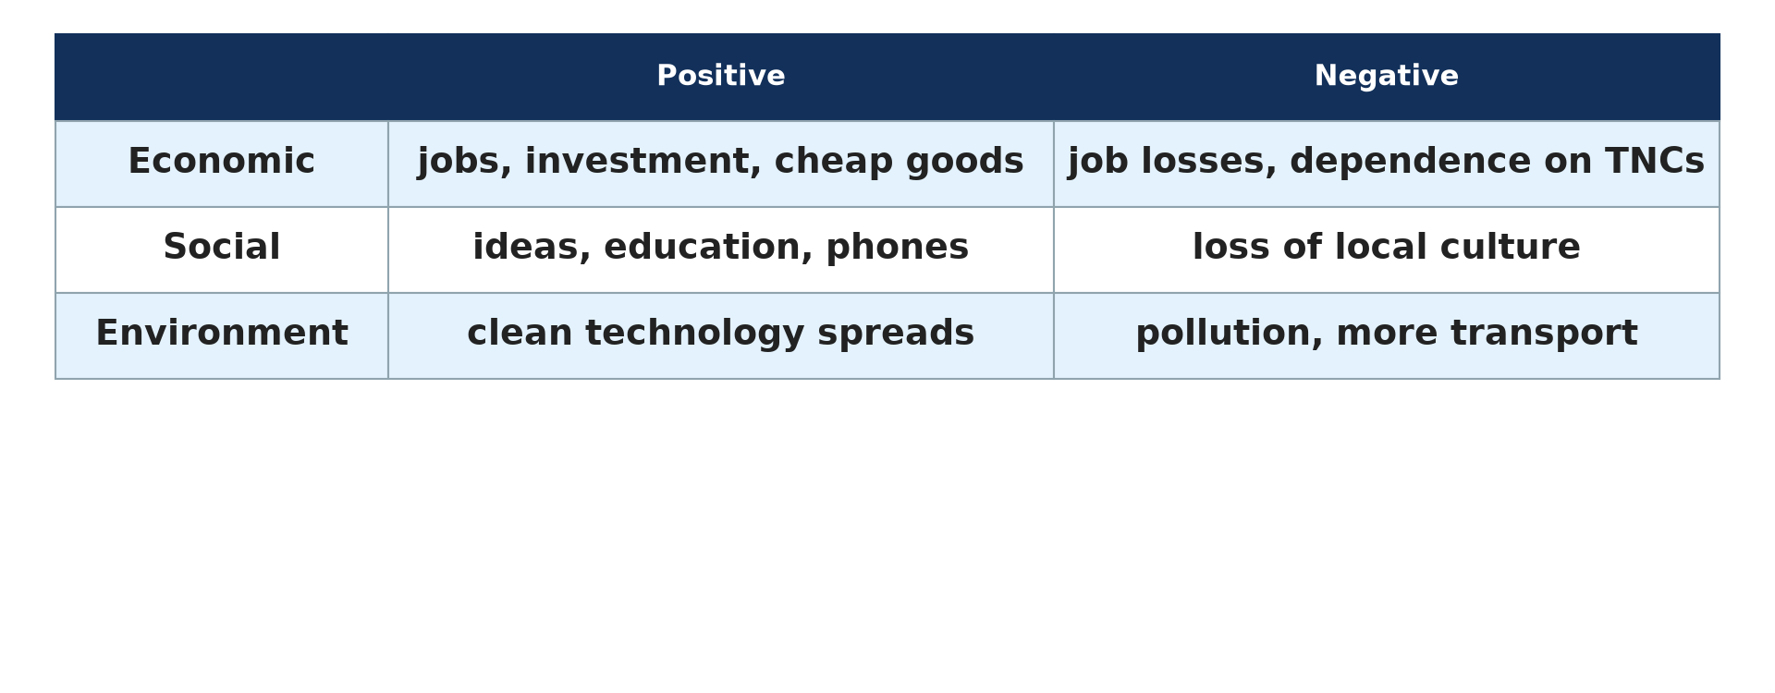
GEOGRAPHY — UPPER SIXTH ARTS
III. IMPACTS
Activity 5
Positive and negative impacts.
2026 / 2027
DGCAST GAROUA — GEOGRAPHY DEPARTMENT
Mr KAMDEM E. | 26
Notes:
Without the projector: sort the impacts.

Slide 27
GEOGRAPHY — UPPER SIXTH ARTS
III. IMPACTS
Activity 5: Question
Give two positive and two negative impacts of globalisation.
2026 / 2027
DGCAST GAROUA — GEOGRAPHY DEPARTMENT
Mr KAMDEM E. | 27

Slide 28
GEOGRAPHY — UPPER SIXTH ARTS
III. IMPACTS
Answer
Positive: jobs, cheap goods. Negative: loss of culture, dependence on TNCs.
2026 / 2027
DGCAST GAROUA — GEOGRAPHY DEPARTMENT
Mr KAMDEM E. | 28

Slide 29
GEOGRAPHY — UPPER SIXTH ARTS
BOARD SUMMARY
Globalisation
Topic: Current Development Issues
Sub-topic: Globalisation
Lesson 10: Globalisation
2026 / 2027
DGCAST GAROUA — GEOGRAPHY DEPARTMENT
Mr KAMDEM E. | 29
Notes:
Learners copy the board summary now. Give them enough time for each slide.

Slide 30
GEOGRAPHY — UPPER SIXTH ARTS
BOARD SUMMARY
I. Definitions
Globalisation: It is the growing links between countries through trade, money, people and information.
TNC: It is a company that produces or sells in many countries.
2026 / 2027
DGCAST GAROUA — GEOGRAPHY DEPARTMENT
Mr KAMDEM E. | 30

Slide 31
GEOGRAPHY — UPPER SIXTH ARTS
BOARD SUMMARY
II. Evidence and Factors (1/3)
A. Evidence: Goods from many countries are sold everywhere and TNCs operate worldwide. Music, food and sport are shared globally.
B. Transport: Container ships and jets carry goods and people cheaply and fast. This is the "shrinking world".
2026 / 2027
DGCAST GAROUA — GEOGRAPHY DEPARTMENT
Mr KAMDEM E. | 31

Slide 32
GEOGRAPHY — UPPER SIXTH ARTS
BOARD SUMMARY
II. Evidence and Factors (2/3)
C. ICT and TNCs: Internet and phones link markets instantly. TNCs spread factories and brands across countries.
2026 / 2027
DGCAST GAROUA — GEOGRAPHY DEPARTMENT
Mr KAMDEM E. | 32

Slide 33
GEOGRAPHY — UPPER SIXTH ARTS
BOARD SUMMARY
II. Evidence and Factors (3/3)
Copy the four components.
2026 / 2027
DGCAST GAROUA — GEOGRAPHY DEPARTMENT
Mr KAMDEM E. | 33

Slide 34
GEOGRAPHY — UPPER SIXTH ARTS
BOARD SUMMARY
III. Impacts
A. Positive: Globalisation brings investment, jobs, cheap goods and new ideas. Poor countries can export more.
B. Negative: Local industries and cultures may disappear and profits leave the country. Inequality and pollution can rise.
2026 / 2027
DGCAST GAROUA — GEOGRAPHY DEPARTMENT
Mr KAMDEM E. | 34

Slide 35
GEOGRAPHY — UPPER SIXTH ARTS
FORMATIVE EVALUATION
Formative Evaluation 1
Give three factors of globalisation.
2026 / 2027
DGCAST GAROUA — GEOGRAPHY DEPARTMENT
Mr KAMDEM E. | 35

Slide 36
GEOGRAPHY — UPPER SIXTH ARTS
FORMATIVE EVALUATION
Expected Answer
TNCs, container shipping and ICT.
2026 / 2027
DGCAST GAROUA — GEOGRAPHY DEPARTMENT
Mr KAMDEM E. | 36

Slide 37
GEOGRAPHY — UPPER SIXTH ARTS
FORMATIVE EVALUATION
Formative Evaluation 2
Give one advantage and one disadvantage of TNCs for Cameroon.
2026 / 2027
DGCAST GAROUA — GEOGRAPHY DEPARTMENT
Mr KAMDEM E. | 37

Slide 38
GEOGRAPHY — UPPER SIXTH ARTS
FORMATIVE EVALUATION
Expected Answer
Advantage: jobs. Disadvantage: profits go abroad.
2026 / 2027
DGCAST GAROUA — GEOGRAPHY DEPARTMENT
Mr KAMDEM E. | 38

Slide 39
GEOGRAPHY — UPPER SIXTH ARTS
REMEDIATION
Remediation
Fill in the blanks:
A company in many countries is a ______.
Metal boxes for goods are ______.
Internet and phones are ______.
2026 / 2027
DGCAST GAROUA — GEOGRAPHY DEPARTMENT
Mr KAMDEM E. | 39
Notes:
Answers: 1. TNC 2. containers 3. ICT

Slide 40
GEOGRAPHY — UPPER SIXTH ARTS
HOMEWORK
Homework
List ten objects in your home and the country where each was made.
This prepares Lesson 11: International Trade.
2026 / 2027
DGCAST GAROUA — GEOGRAPHY DEPARTMENT
Mr KAMDEM E. | 40
Notes:
This homework prepares the next lesson.

Slide 41
GEOGRAPHY — UPPER SIXTH ARTS
BILINGUAL GAME
Bilingual Game (Jeu Bilingue)
English | Français
Globalisation | La mondialisation
Company | L'entreprise
Container | Le conteneur
Internet | Internet
Culture | La culture
Brand | La marque
2026 / 2027
DGCAST GAROUA — GEOGRAPHY DEPARTMENT
Mr KAMDEM E. | 41
Notes:
Say the English word; learners give the French word, then the reverse.

Slide 42
GEOGRAPHY — UPPER SIXTH ARTS
LOGBOOK
Official Logbook (1/2)
Module / Topic | Current Development Issues
Lesson Title | Lesson 10: Globalisation
Expected Learning Outcomes | Define globalisation and its components. Explain the factors of globalisation. Evaluate its positive and negative impacts.
Competence | Learners are able to explain globalisation, its factors and impacts.
2026 / 2027
DGCAST GAROUA — GEOGRAPHY DEPARTMENT
Mr KAMDEM E. | 42

Slide 43
GEOGRAPHY — UPPER SIXTH ARTS
LOGBOOK
Official Logbook (2/2)
Matter Taught | I. Definitions: Globalisation, TNC; II. Evidence and Factors: Evidence, Transport, ICT and TNCs; III. Impacts: Positive, Negative.
Evaluation | Formative evaluation (3 questions) and remediation exercise.
Homework | List ten objects in your home and the country where each was made.
Enrolment / Present / Absent | ____ / ____ / ____
Achievement | To be completed by the teacher after the lesson.
2026 / 2027
DGCAST GAROUA — GEOGRAPHY DEPARTMENT
Mr KAMDEM E. | 43

Slide 44
GEOGRAPHY — UPPER SIXTH ARTS
TEACHER'S NOTE
Teacher's Note
Timing: Set-up, recall 8 min | Situation 8 min | 5 activities 30 min | Board summary (copying) 30 min | Evaluation, remediation 10 min | Homework, logbook 9 min | Spare 5 min
2026 / 2027
DGCAST GAROUA — GEOGRAPHY DEPARTMENT
Mr KAMDEM E. | 44

Slide 45
GEOGRAPHY — UPPER SIXTH ARTS
REFERENCES
References
National Geography Syllabus, Sixth Forms (Lower & Upper Sixth), MINESEC/IGE/IP-SS, August 2019 — Module 7 (Environment and Development).
Photo, Activity 2: “Container Ships @ Port of Oakland” by jdnx, CC BY 2.0, via Flickr (https://www.flickr.com/photos/21442511@N08/3464243881)
Photo, Activity 4: “Woman uses a computer in an internet cafe” by World Bank Photo Collection, CC BY-NC-ND 2.0, via Flickr (https://www.flickr.com/photos/10816734@N03/7556691396)
Diagrams and animations: drawn for this lesson (DGCAST Geography Department).
2026 / 2027
DGCAST GAROUA — GEOGRAPHY DEPARTMENT
Mr KAMDEM E. | 45

